Slide 1

Python Control Structures - 2
Functions and Modules
Program: EDGE-CSE CUET DIGITAL SKILLS TRAINING
Course: Python (Django) [Intermediate]
Lecture: Training Session-03 Part-1 Date: 19th September, 2024 Duration: (25 + 35) mins
Instructor: Tanveer Rahman, Sr. Software Engineer, Friends Corp. Chuo-ku, Tokyo, JP shakil10vr@hotmail.com, 01626735005

Slide 2
Function in Python
What is Function?
A function is a block of organized, reusable code that performs a single action.
Benefits of Functions:
Code Reusability
Better code organization
Easier debugging
Syntax:
def function_name(params): # code block return value

Slide 3
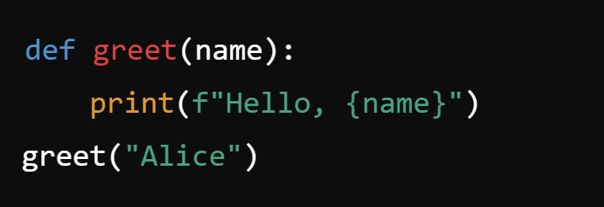
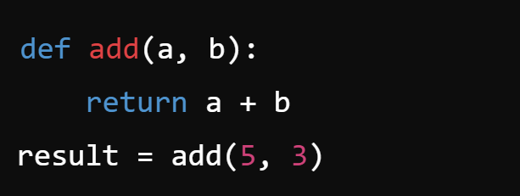
Creating Functions
Example:
Parameters and Return Values
Functions can accept inputs (parameters) and return outputs.
Example of return value:

Slide 4
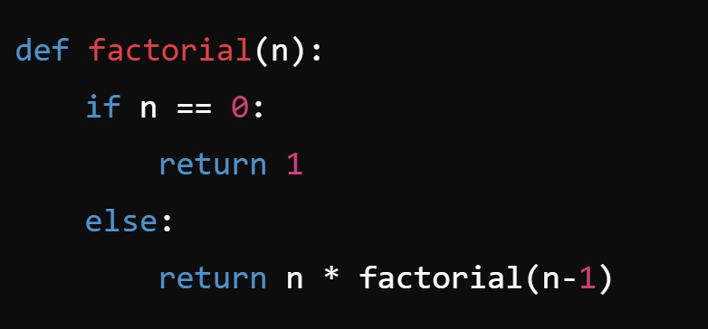
Task - 1
Task 1 (15 mins):
Create a function that calculates the factorial of a number.
Input: Integer
Output: Factorial of the number
Example:

Slide 5
Python Modules
Definition: A module is a file containing Python code that you can import into another script.
Built-in Modules:
math, random, datetime, etc.
Creating Custom Modules:
Save the Python file (e.g., my_module.py) and import it using import my_module.

Slide 6
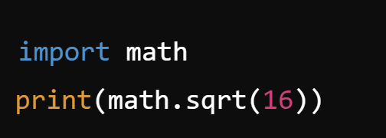
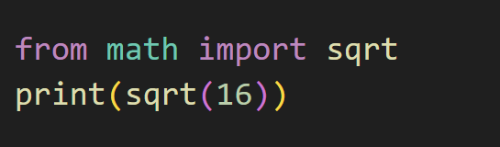
Importing Modules
Import Syntax:
import module_name
or import specific parts:
from module_name import function_name
Example:

Slide 7
TASK 2
Task 2 (20 mins):
Create a custom module that contains two functions:
Function to convert temperatures (Celsius to Fahrenheit).
Function to calculate the area of a circle.
Import the module and use these functions in another Python script

Slide 8
RECAP
Functions:
Modules:
Modules help organize and reuse code across different programs.
Functions improve code reusability and readability.

Slide 9

Q&A Session

